Slide 1
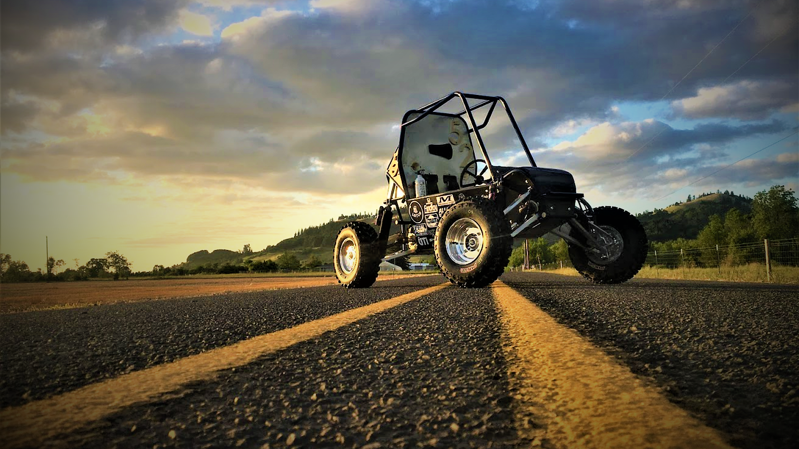
2021 SAE Baja
1

Slide 2
Project Description
Table 1: Sub-Team Roster
The Baja capstone team aims to compete in the annual West Coast SAE BAJA Competition, where we can showcase our knowledge of vehicle design to other schools and automotive industry representatives.
Team of 13 undergraduate Mechanical Engineering Students
  4 Sub-teams: Frame, Drive Train, Front End, Rear End
SAE Baja sponsors are: Society of Automotive Engineers, W.L Gore & Associates, Lucas Inc., Arce, Bro-Tools, Home Depot, and others. These companies provide funding for our project, which could potentially cost upwards of $30,000.
With 4 Wheel Drive included as part of this year's project, the design can guide future NAU SAE Baja teams to succeed in competition.
Frame | Drive Train | Front End | Rear End
Brendan P. | Tyler T. | Tanner G. | Colton L.
Brian C. | Emily K. | Jacob K. | Logan F.
Ashley R. | Connor H. | Ryan M. | Bailey M.
Matthew W.
2

Slide 3
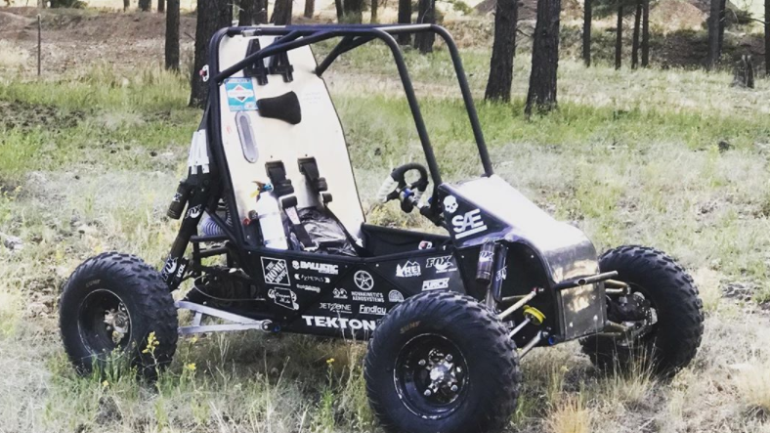
Background
Current designs try to achieve high strength characteristics while trying to be as light as possible.
Approaches to fulfill competitions requirements were fulfilled by looking at old vehicle designs as well as photos of other teams on the Baja SAE website.
Engineering and customer requirements are heavily based off the rule package as well as pushing for innovation to possibly implement technology into the automotive industry.
  Vehicle efficiency
  Vehicle durability
  Vehicle safety
  Improvements to vehicle manufacturing techniques
Our improvements from previous years designs include adding a 4WD system to earn extra points in the competition
Maintain <400lb weight with added system
Considering the use of a chain even though they are a rare power transmission system in the competition.
3

Slide 4
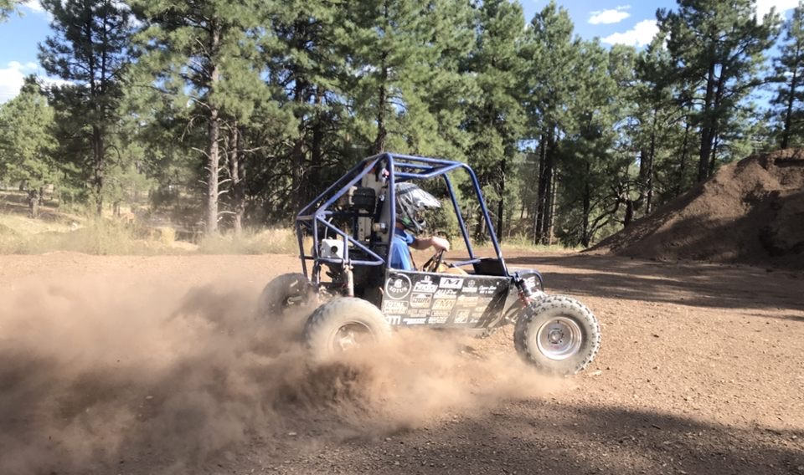
Current Project State
Existing Designs/Shortcomings
  Referencing Baja's from previous years
    Previous issues with turning intend to be solved
    Spatial issues in the rear intend to be predetermined and avoided
    Proper suspension geometry to avoid binding
Ideas from Different Applications
  Motorcycle drive chains
4

Slide 5
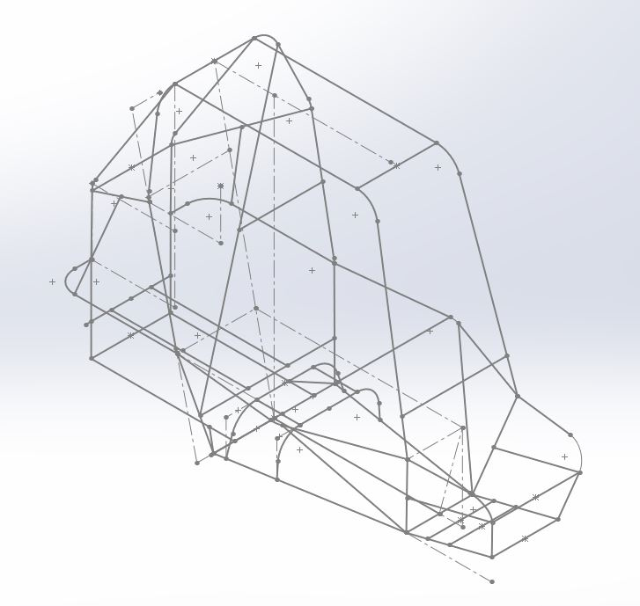
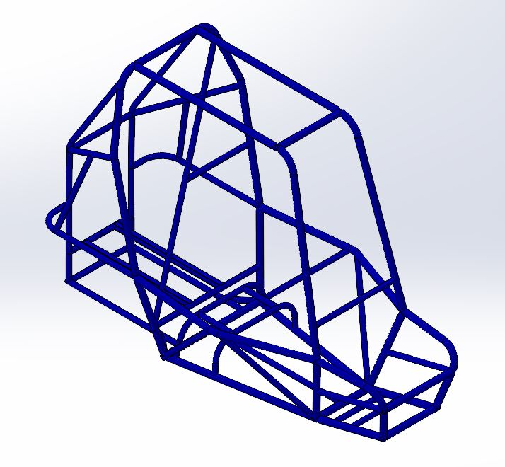
Frame Updates
After research and benchmarking previous projects, a rear braced design was selected, using a previous year's frame design as a starting point
The frame has been designed using a wire model on SOLIDWORKS
Utilizing the weldment tool, the team was able to efficiently add in the new structural members
The selected material for the members is 4130 steel
Figure 1: Wire Model
5
Figure 2: Fully-Modeled Frame with Weldments

Slide 6
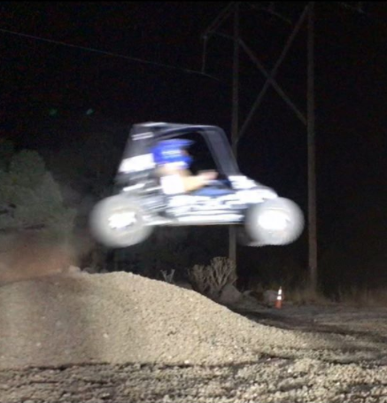
Customer Requirements
Customer Requirements Include:
• Priority Requests from 2021 SAE Baja Rulebook
  Standard Briggs and Stratton 10hp motor
  Width Requirements (64 in. Max)
  Safety Requirements (Design of Frame Roll Cage)
  Inexpensive Design (>25,000$)
• Optional Customer Requirements:
  4WD System (Bonus Points)
  Highly Maneuverable
  Lightweight
  Design for Manufacturing and Assembly
  Improved Acceleration
  Comfort of Driver
6

Slide 7
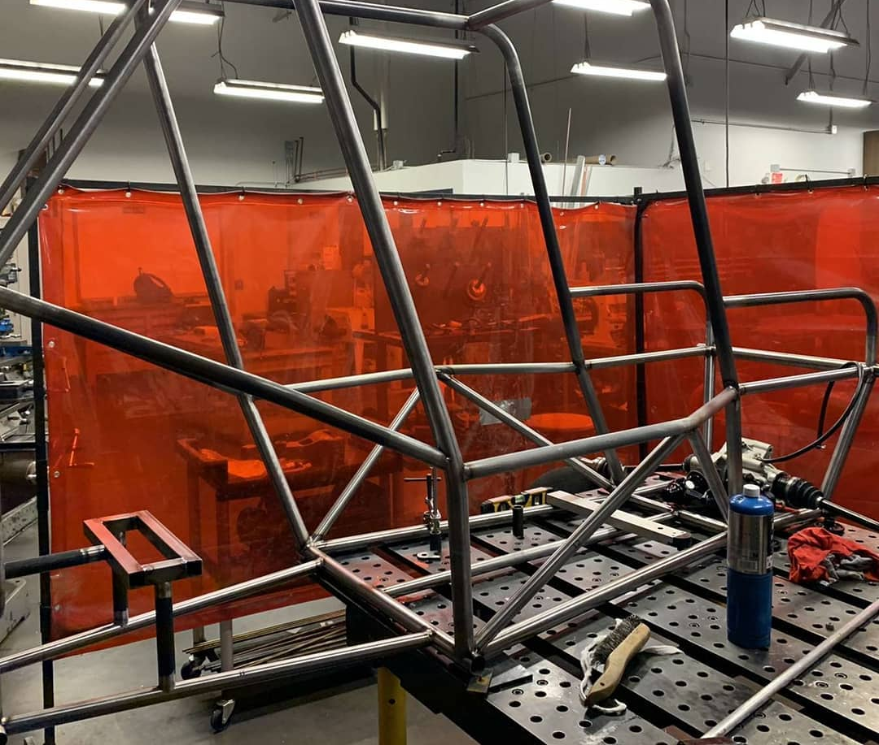
Engineering Requirements
Must be able to cover 100ft in under 4.5 seconds from a standstill
4WD system weight to be kept under 50lbs
20% reduction in moments of inertia from previous years' rotating parts
Turning radius must be 8.5ft or less
Top speed of 27MPH
Curb weight to be no more than 395lbs
7

Slide 8
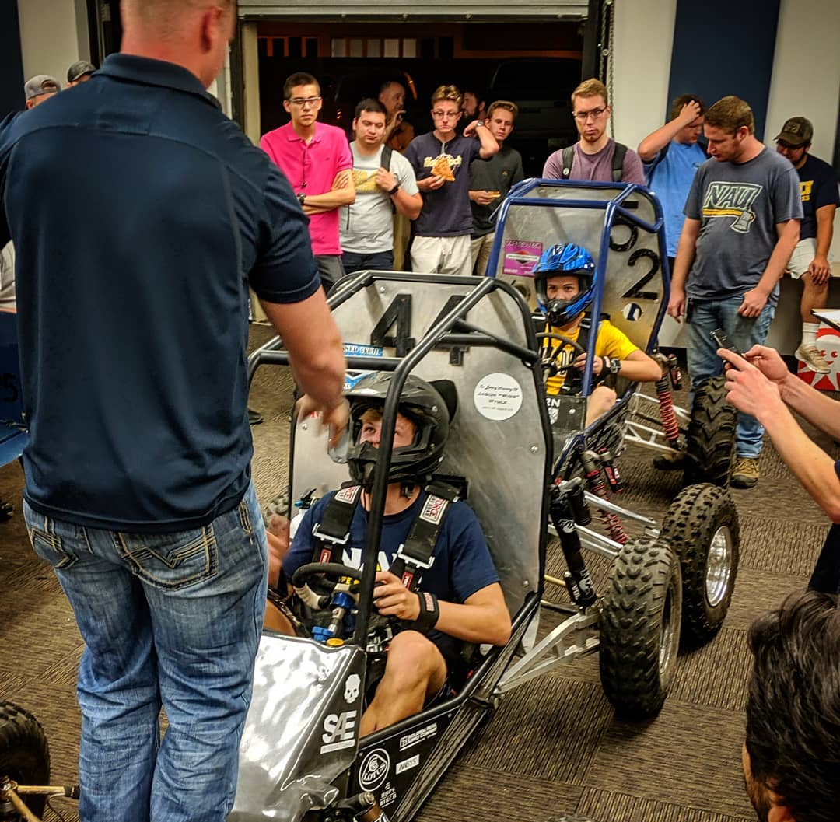
Thank you!
8

